Slide 1
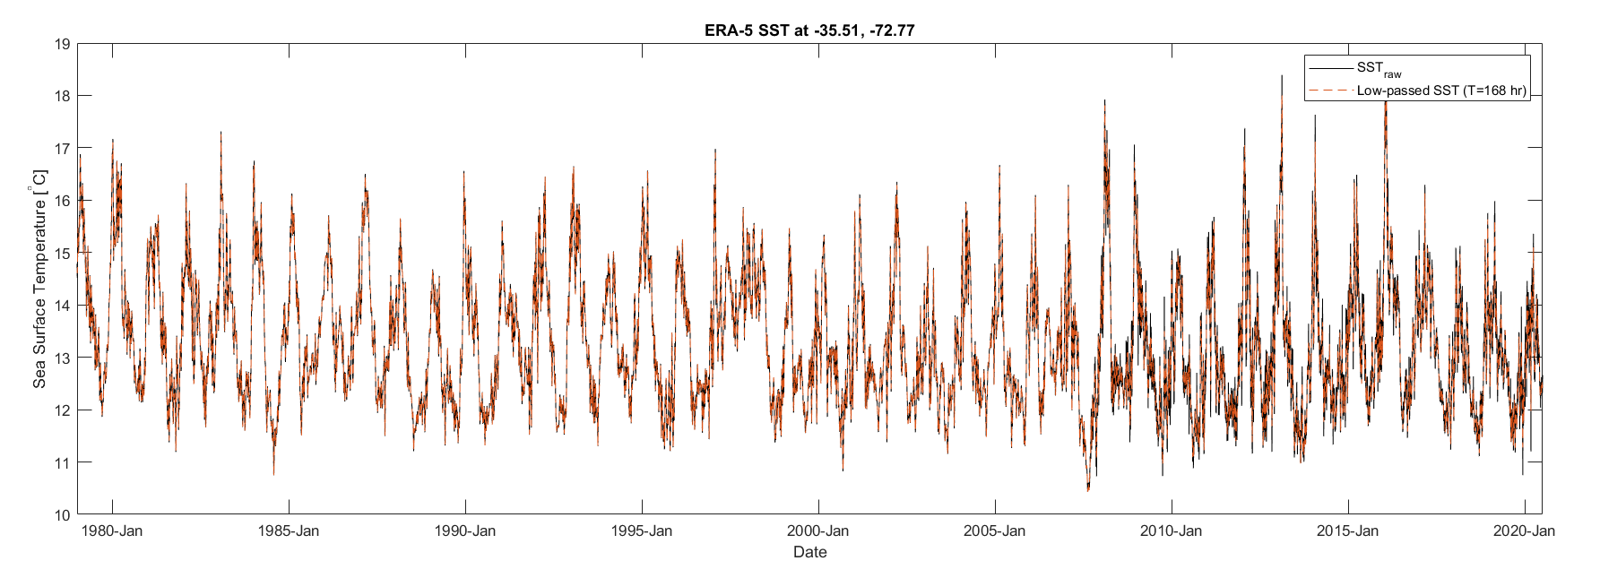
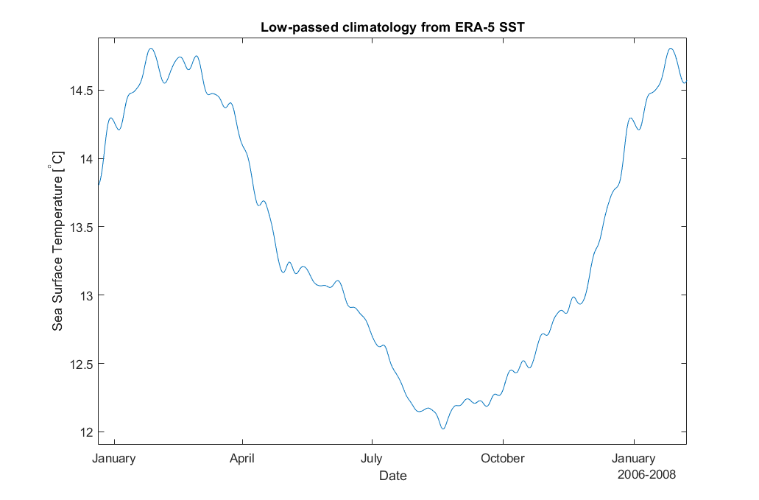

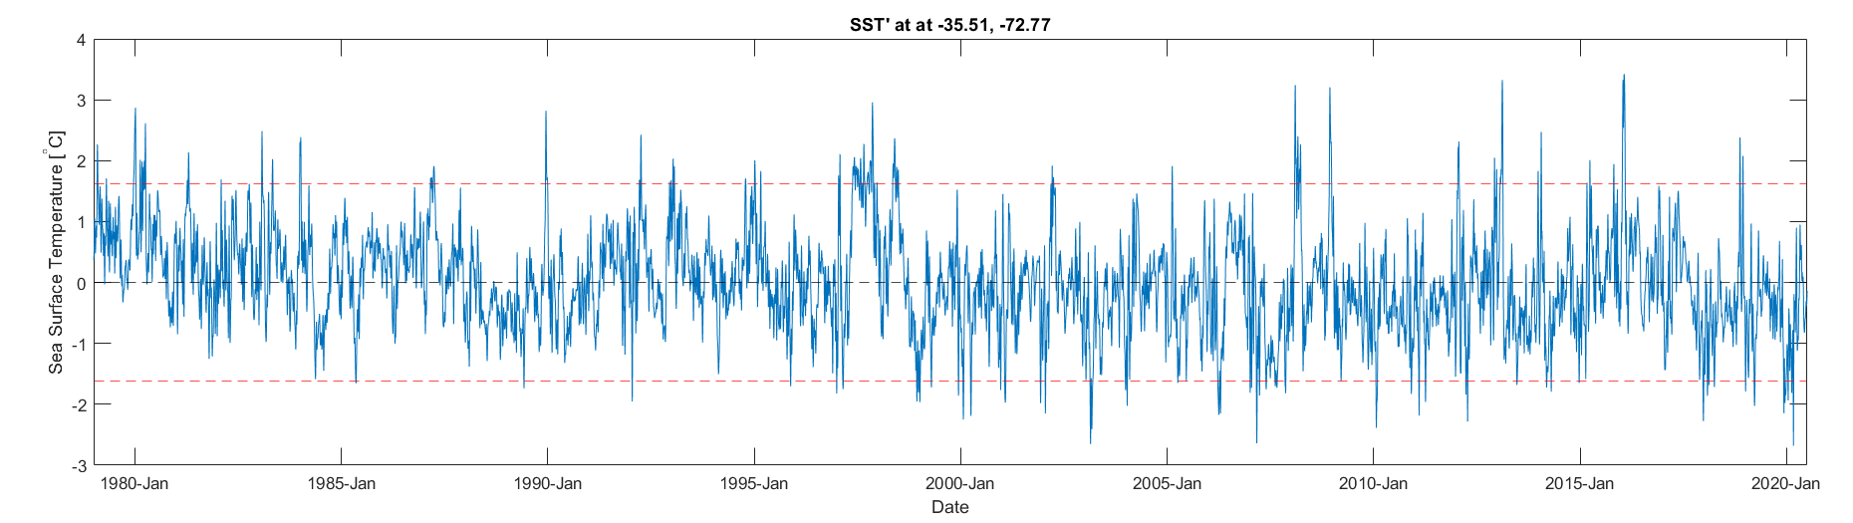
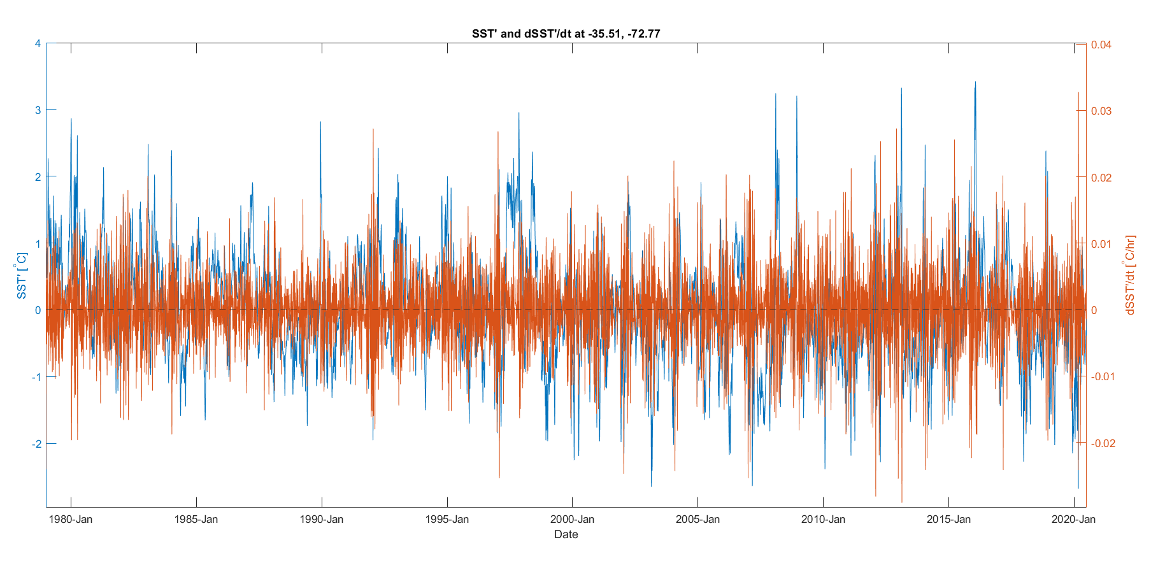
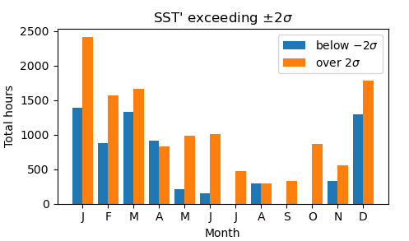
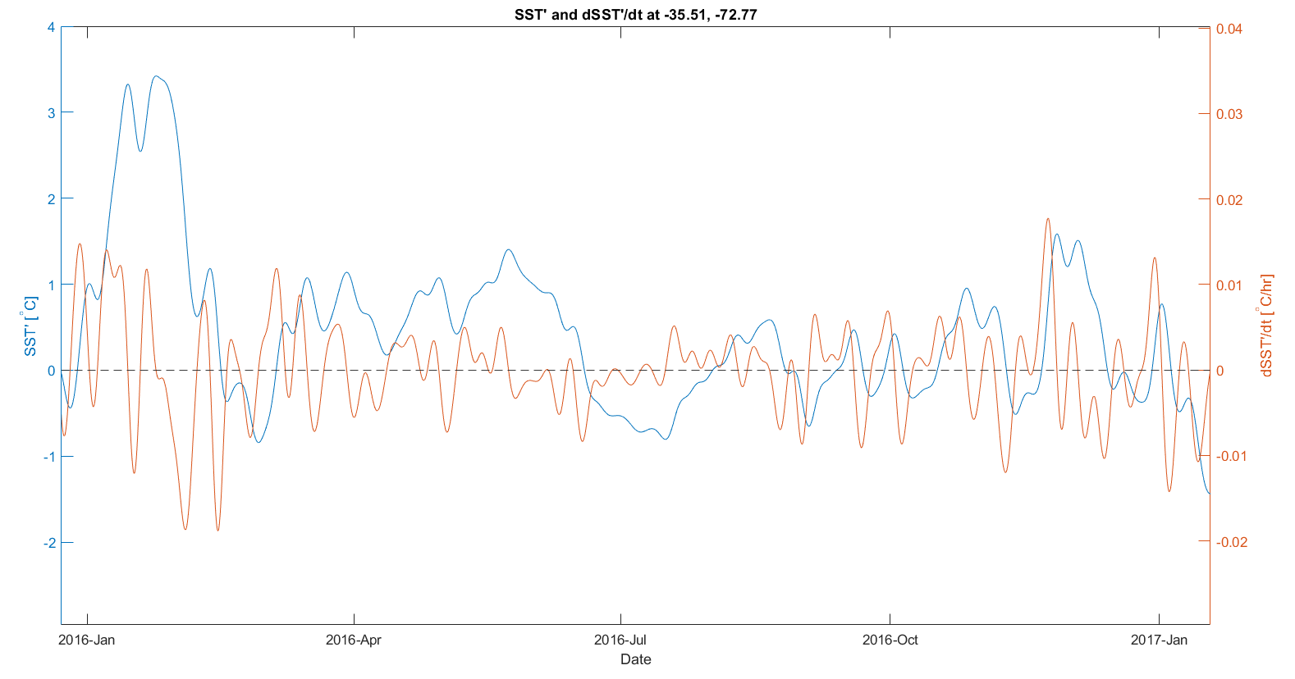
Marine heat waves in the Chile-Peru Eastern Boundary Upwelling System:
~~~~Ammo Bar ~~~~
rates of change in sea-surface temperature anomalies near a major upwelling center
Of all SST anomalies in the Punta Lavapie Upwelling Center, the most extreme are dominated by positive anomalies which occur most often in December through February.
Presenter:
Kylene Cooley
Background:
Marine heat waves like those in the California Current System (CCS) have also been observed in the Chile-Peru System (CPS)
Dominant forcings of wind relaxations in the CCS have been found through analysis of the surface ocean heat budget
Methods:
Obtain European Centre for Medium-Range Weather Forecasts reanalysis (ERA5) hourly SST
Define periods of intense warming as departures from climatology
Sort these times based on annual and seasonal occurrence
Take time derivative of SST’ for rates of anomalous warming
Authors:
Kylene Cooley, Melanie R. Fewings, Jim Lerczak
Oregon State University, CEOAS
cooleyky@oregonstate.edu
Future Work:
examine terms in the sea surface heat budget for which are dominant during different times
References and Acknowledgements: Flynn et al. (2017)

Slide 2
Marine heat waves in the Chile-Peru Eastern Boundary Upwelling System:
Rates of change in sea-surface temperature anomalies near a major upwelling center
Presenter:
Kylene Cooley
cooleyky@oregonstate.edu
Authors:
Kylene Cooley, Melanie R. Fewings, Jim Lerczak
Oregon State University, CEOAS

Slide 3
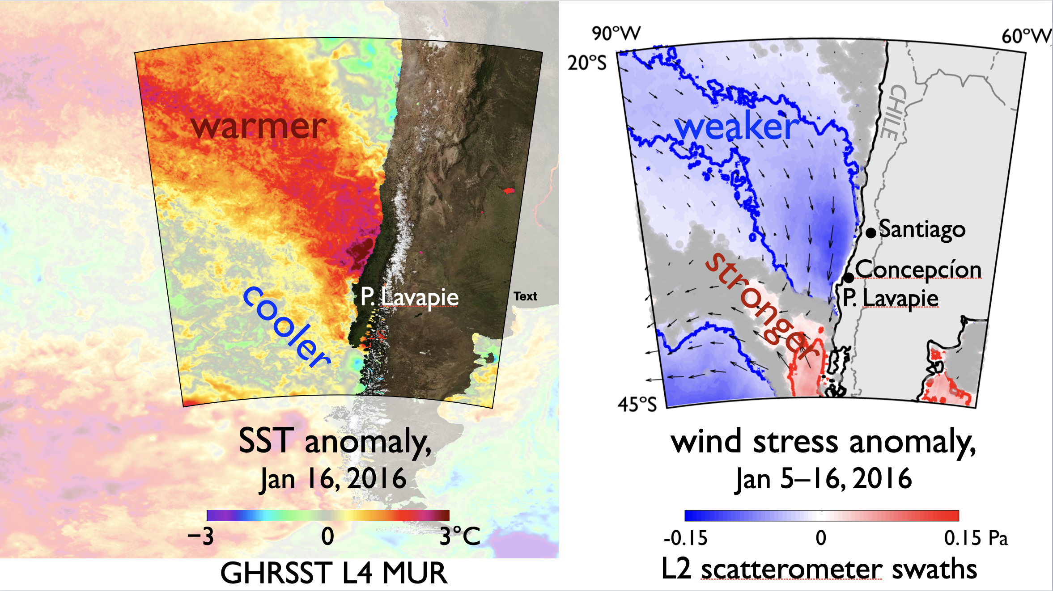
Marine heat waves (MHWs) affected the Chile-Peru System (CPS) in 2014-2016 and 2019-2020
Background:
The relationship between
warm (cold) SST and weak (strong) wind stress anomalies
in the California Current System (CCS) during MHWs
has also been observed in the CPS
Similar dipole structures
in wind stress and sea surface temperature (SST)
as Fewings and Brown 2019 observed in the CCS

Slide 4
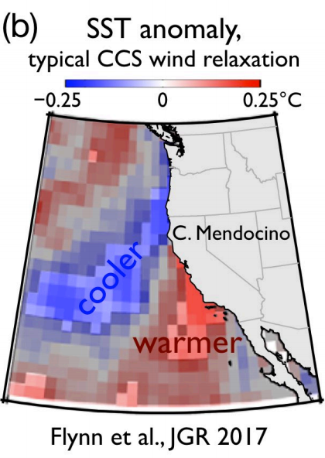
Dominant forcing mechanisms of the surface ocean heat budget in the CPS during MHWs are not well defined
Dominant forcing mechanisms during wind relaxations in the CCS have been found through analysis of the surface ocean heat budget
Surface latent heat flux
Decreased entrainment and Ekman pumping at the mixed layer base
Do these processes also drive MHW warming in the CPS?

Slide 5
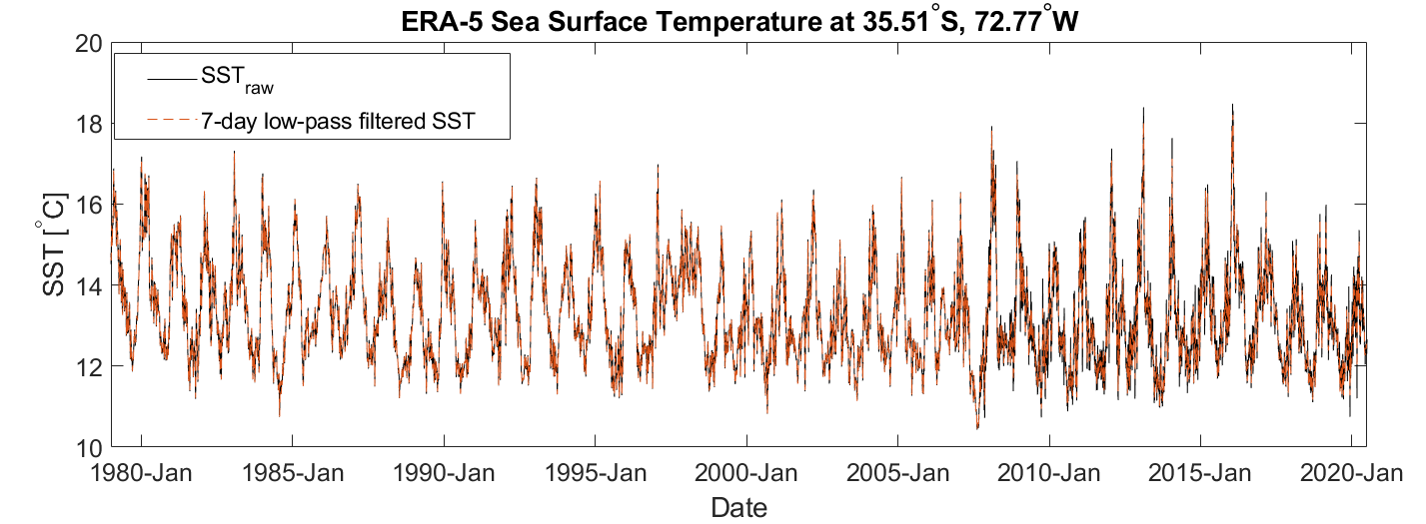
Isolating strong warm anomalies in CPS, Part 1
We use SST near Punta Lavapié upwelling center from 5th generation European Centre for Medium-Range Weather Forecasts reanalysis (ERA5)
Notes:
Methods:
Obtain European Centre for Medium-Range Weather Forecasts reanalysis (ERA5) hourly SST 1979-2020
Low-pass filtered to exclude 7-day and faster periods with pl66 filter

Slide 6
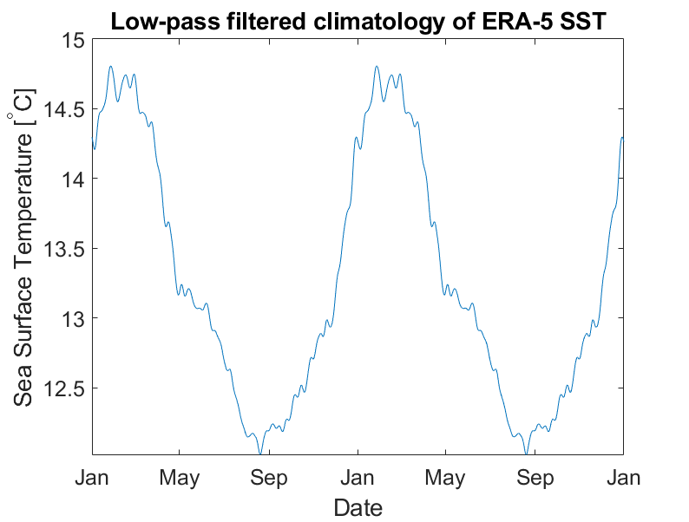
Isolating strong warm anomalies in CPS, Part 2
First, we calculate the climatological annual cycle
Notes:
Climatology derived from ERA-5 SST and processed with 7-day pl66 filter

Slide 7
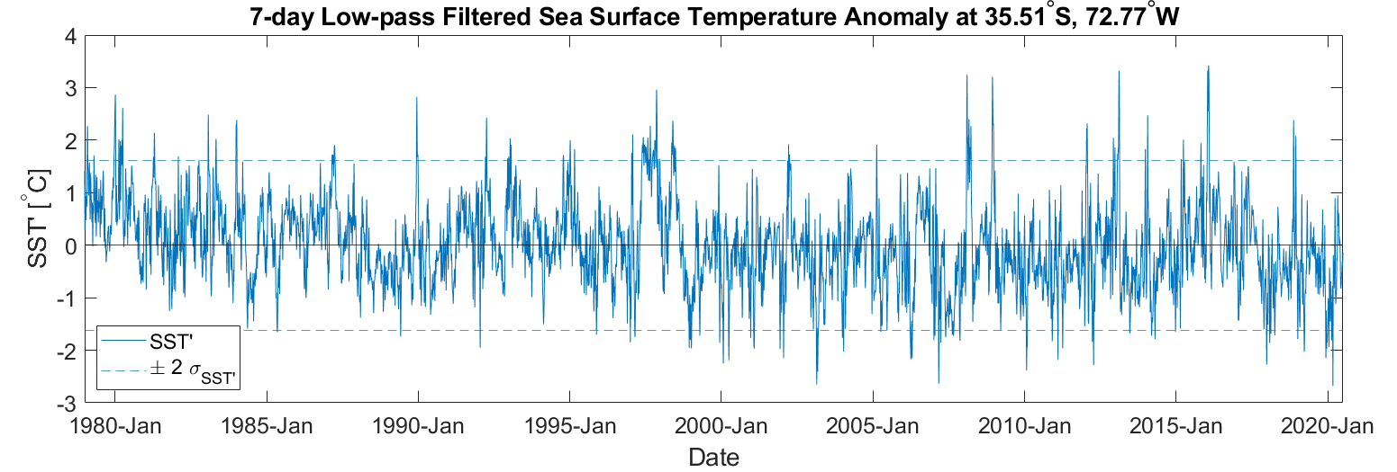
Isolating strong warm anomalies in CPS, Part 3
We focus on periods of intense warm anomalies
where SST’ exceeds two standard deviations from the mean
Notes:
Mention that SST’ is the SST anomaly
Points above top red line

Slide 8
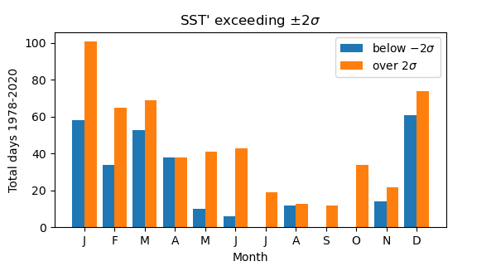
Isolating strong warm anomalies in CPS, Part 4
Strong warm (and cold) anomalies occur most often in December through March

Slide 9
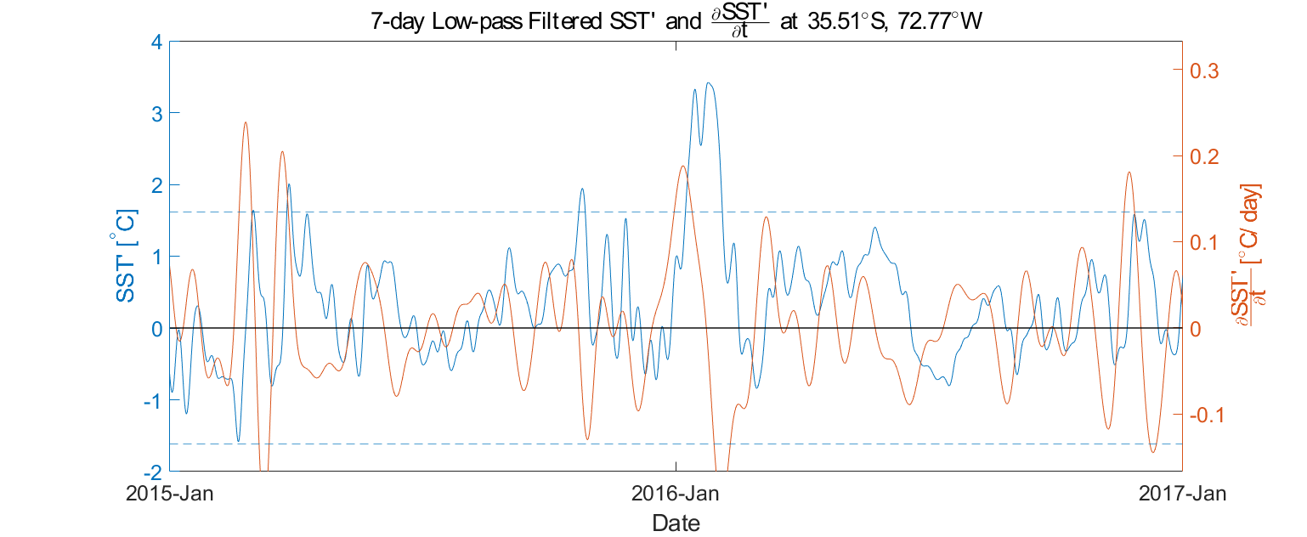
Calculating rates of anomalous warming
Estimate time derivative of the temperature anomaly, SST’,
to determine time periods of warming leading to peaks in SST’
Notes:
In one year we can better see how periods of ocean surface heating precede the warmest events. Especially peak in SST’ in Jan of 2016 which was highlighted in the proposal.
Three episodes of stronger warming contributed to highest peak in SST’.
+dSST’/dt inform when to calculate surface ocean heat budget terms
3-week low-pass filtered to show total warming that contributes to strong warm anomaly in proposal

Slide 10
Future Work:
•Sea surface mixed layer heat budget for each period of anomalous warming following Flynn et al. 2017; Fewings and Brown 2019
•Examine which terms are dominant leading to warmest periods
•Utilize satellite ocean vector wind data, ERA5 and satellite-derived air-sea heat fluxes OAFlux and SeaFlux, and Argo floats
What do we hypothesize finding?
Different forcing mechanisms in northern and southern SST anomaly regions
Warming in northern region mimics CCS southern region forcing mechanisms:
Decreased entrainment and Ekman pumping at mixed layer base
Additional warming driven by advection of SST gradients

